Slide 1
AI application in cryo-ET
沈盈君

Slide 2
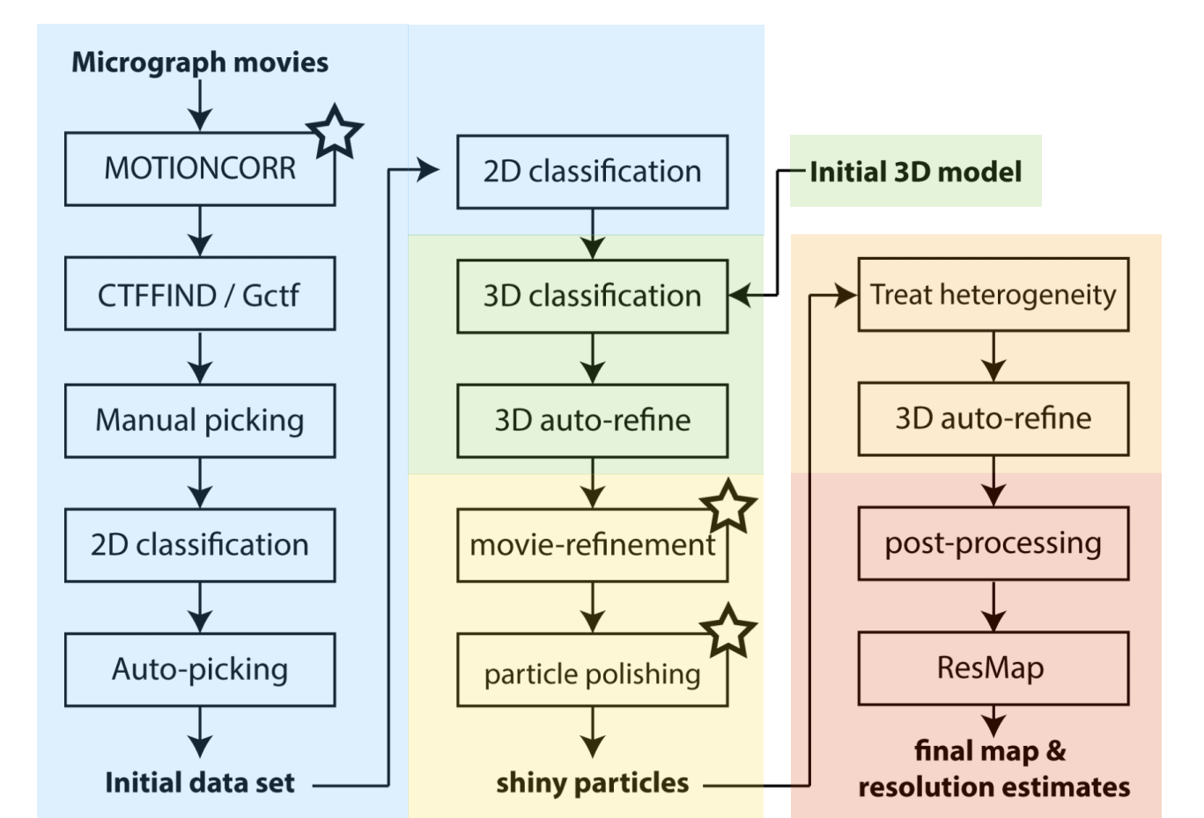
Cryo-EM workflow

Slide 3
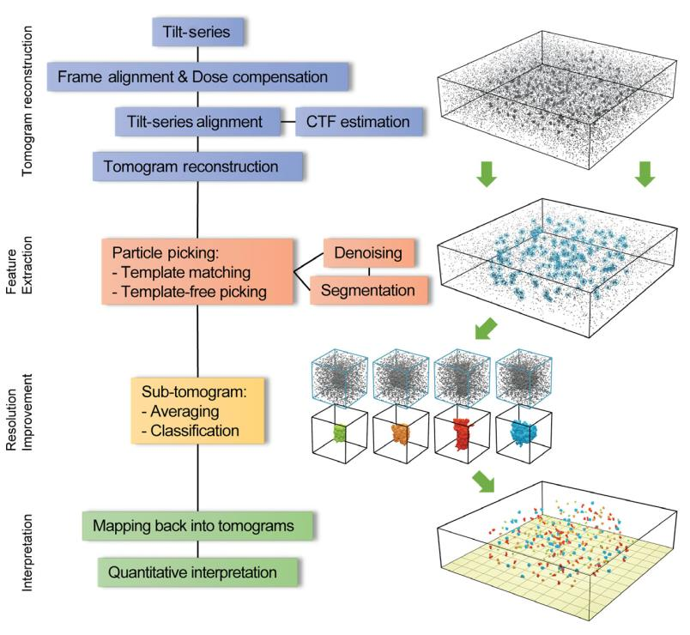
Cryo-ET workflow

Slide 4
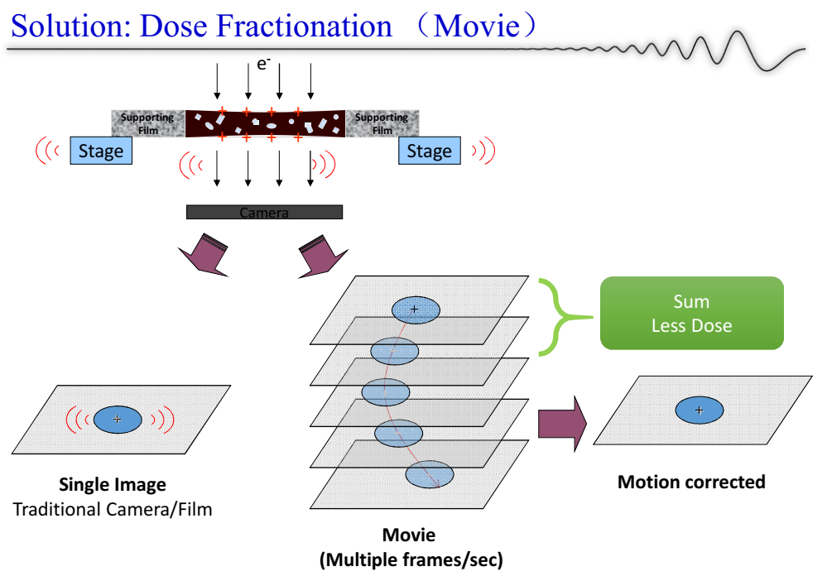
Motion correction

Slide 5
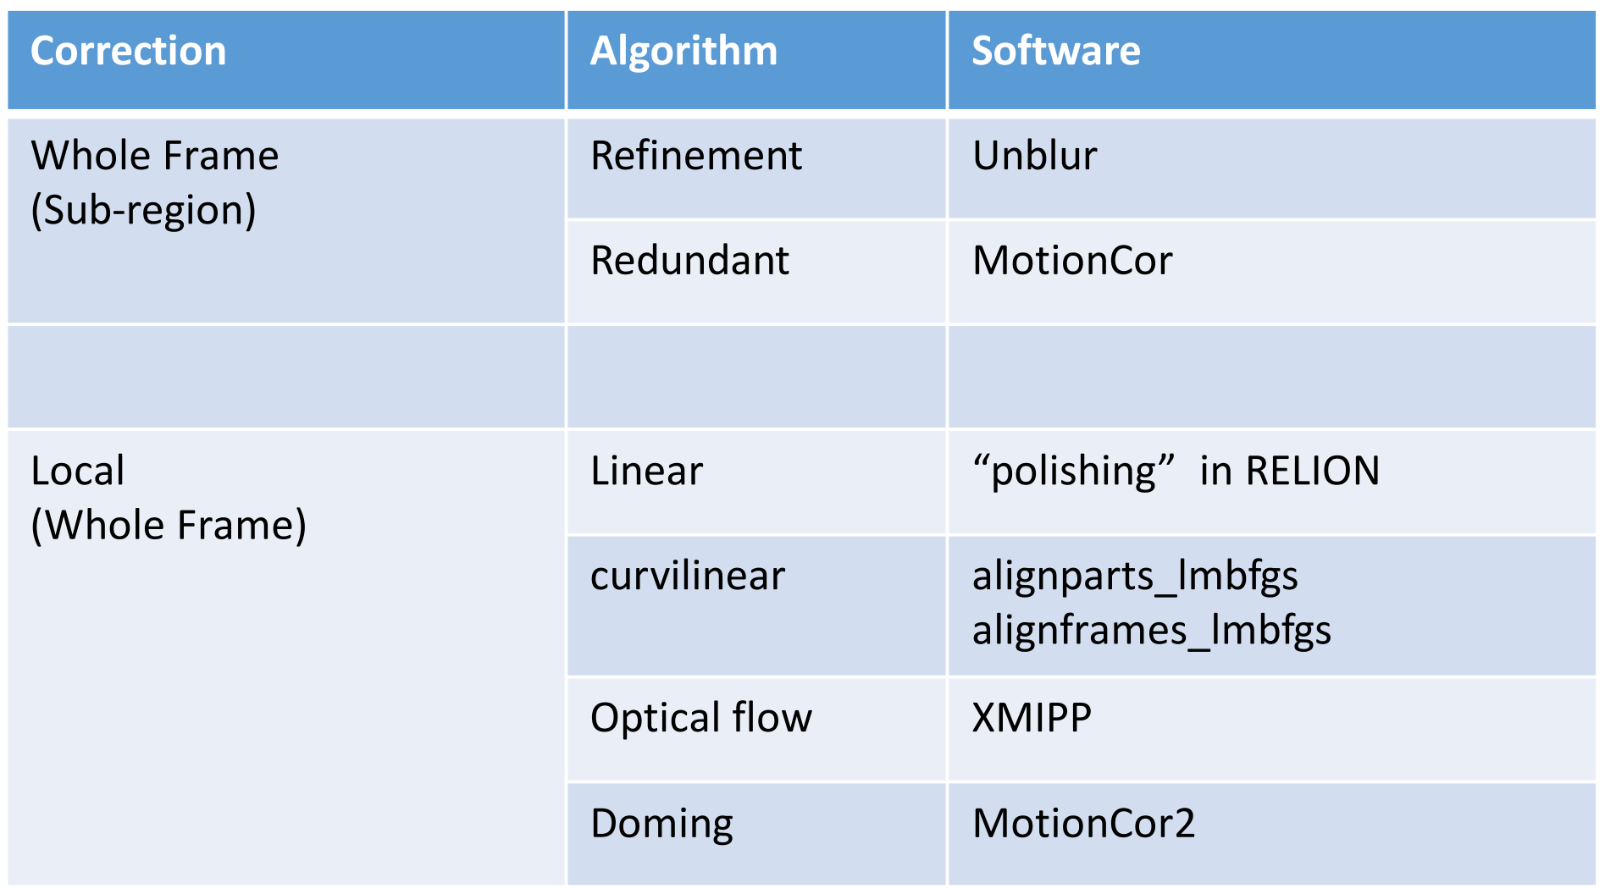
Motion correction model

Slide 6
Motioncor2--global correction
The global motion is corrected iteratively by calculating cross correlation of each sub-frame against the sum of all other sub-frames based upon the alignment of the previous iteration.

Slide 7
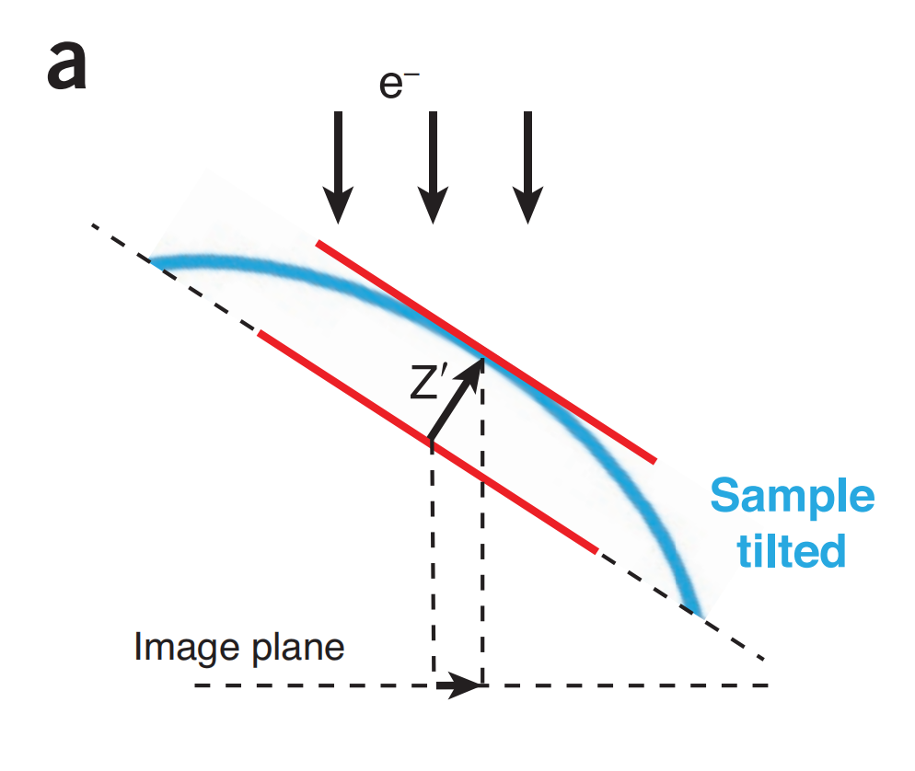
Motioncor2--doming model
When the electron beams hit the sample, sample will have a significant motion pendicular to the sample plane.
This motion is considered sperately at different local regions. Thus, frames are divided into patches after global correction.

Slide 8
Motioncor2--doming model
In theory, the local motion is different on each pixel. So the patch should be small as possible.
But due to the extremely low SNR, motion will be corrected with low accuracy if patch is too small.

Slide 9
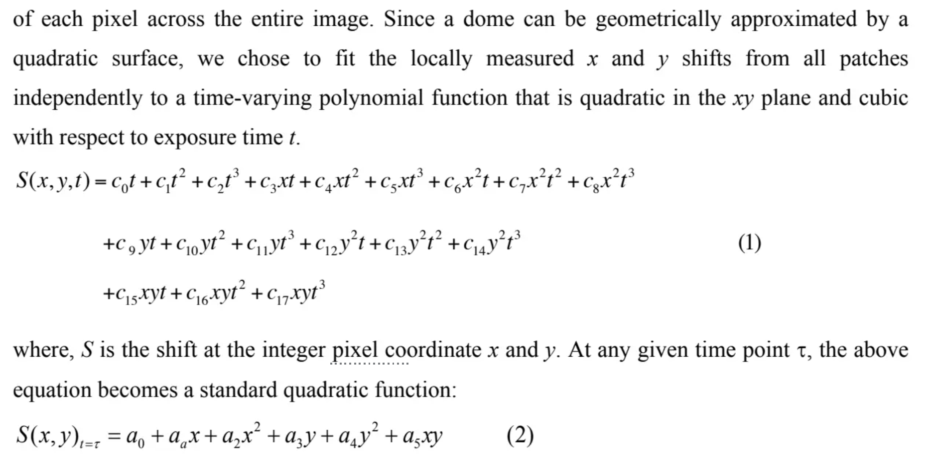
Motioncor2--doming model
Benefits:
eliminate checkboard artifact
more complete motion
smooth

Slide 10
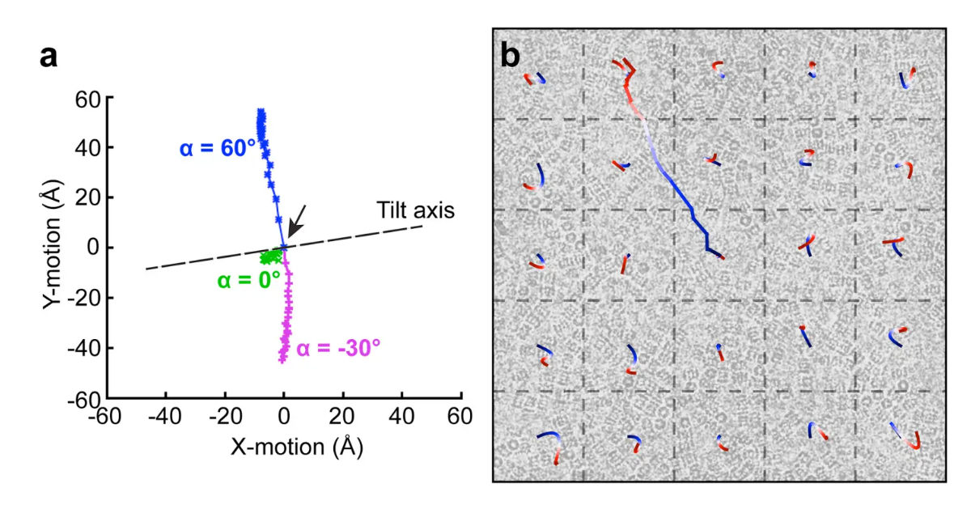
Motioncor2--doming model

Slide 11
Motioncor2--doming model
The measured global shifts are corrected by phase shifting in the Fourier domain to yield a global-motion-corrected stack.
The local shifts are done in real space and use bilinear interpolation. The final image is obtained by cropping the corrected sum in Fourier domain to the user specified resolution.

Slide 12
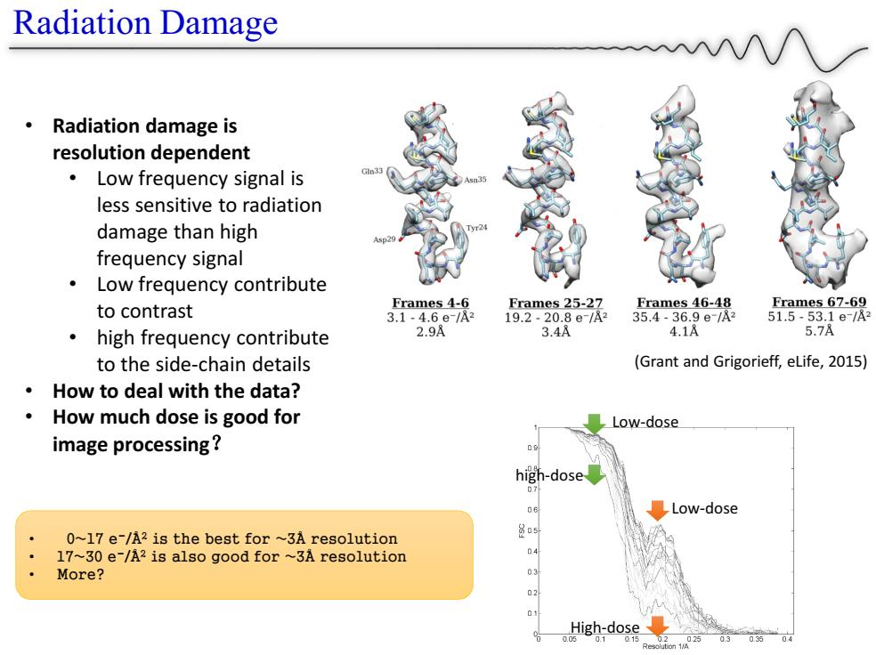
Motioncor2--dose weighting
Weighting movie frames with respect to the dose.

Slide 13
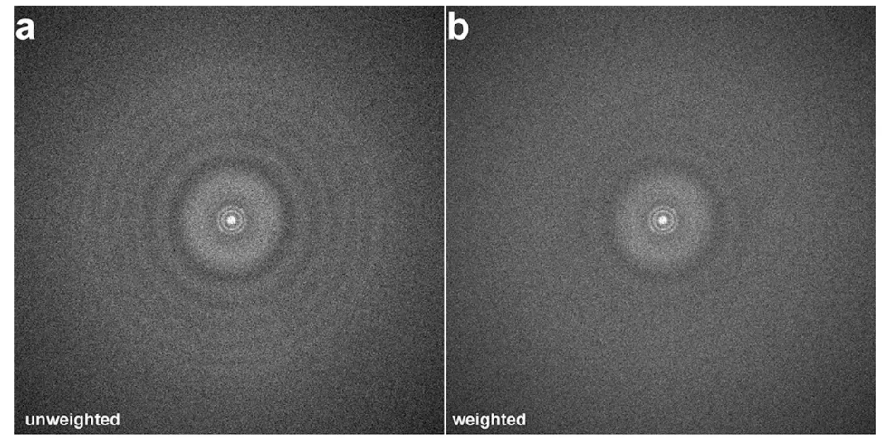
Motioncor2--dose weighting
Down-weighting movie frames with high dose can generate better result.
But, it may attenuates the high resolution Thon ring signals use for CTF estimation.

Slide 14
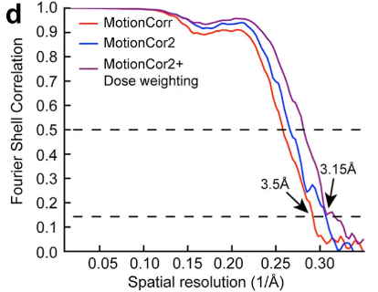
Motioncor2--dose weighting

Slide 15
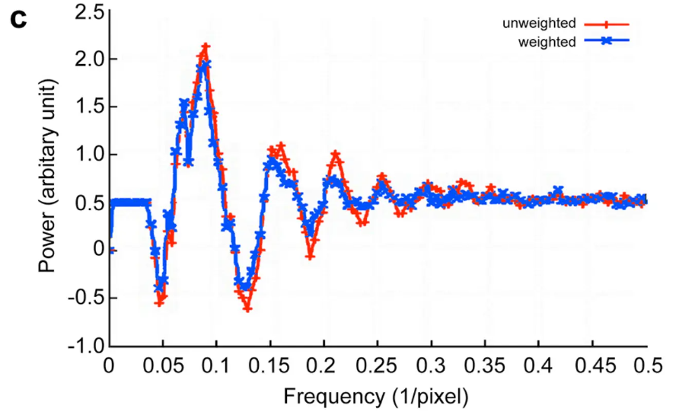
So MotionCor2 produce both results. Weighted one for the following reconstruction and unweighted for CTF estimation.

Slide 16
Cryo-ET workflow

Slide 17
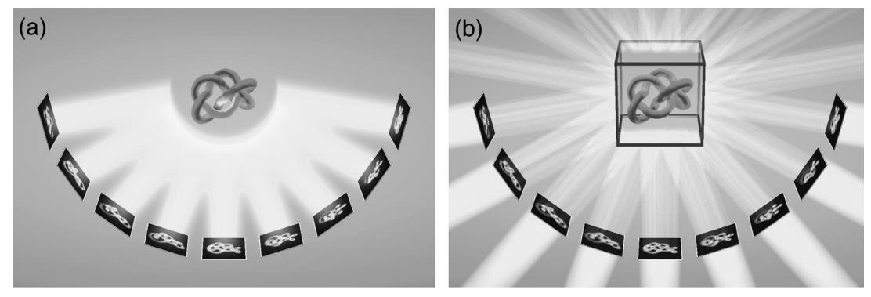
Cryo-ET reconstruction
Cryo-ET’s difference from traditional NeRF:
parallel rays (not pinhole camera)
density-only projection (not volume rendering)

Slide 18
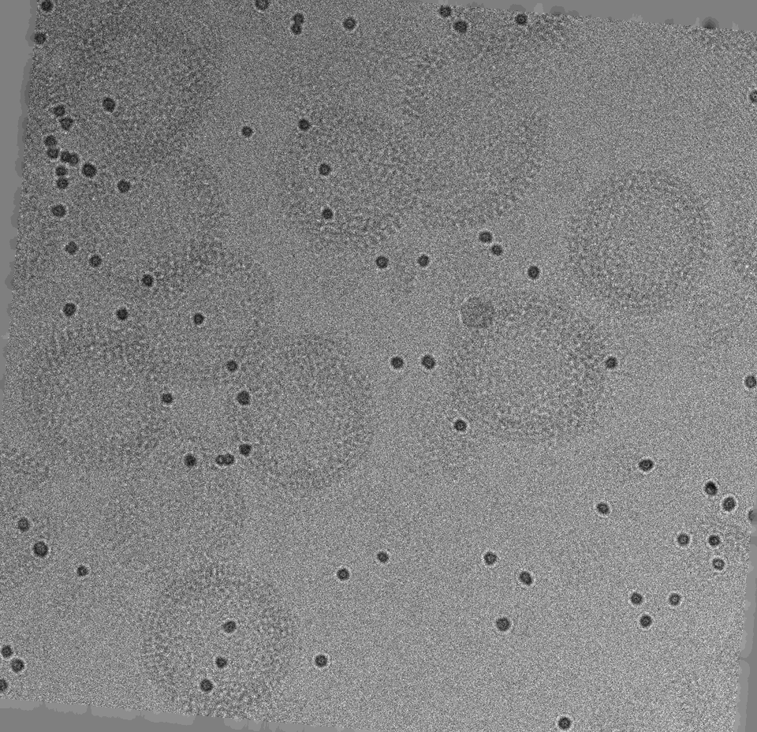
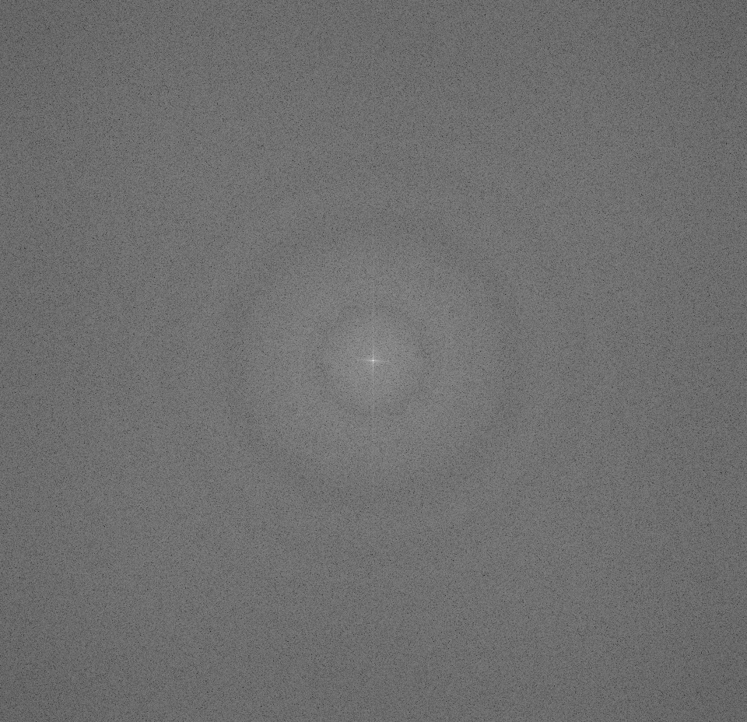
Cryo-ET reconstruction--WBP
CTF Thon ring
original image
FFT

Slide 19
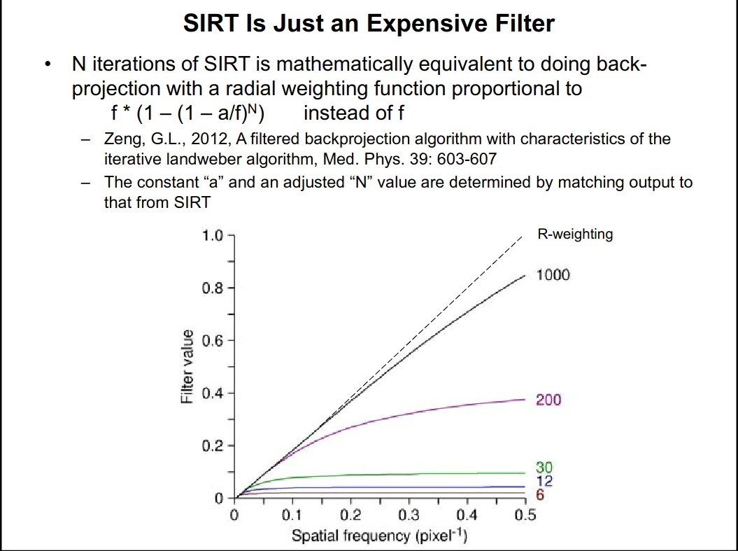
Cryo-ET reconstruction--SIRT filter

Slide 20
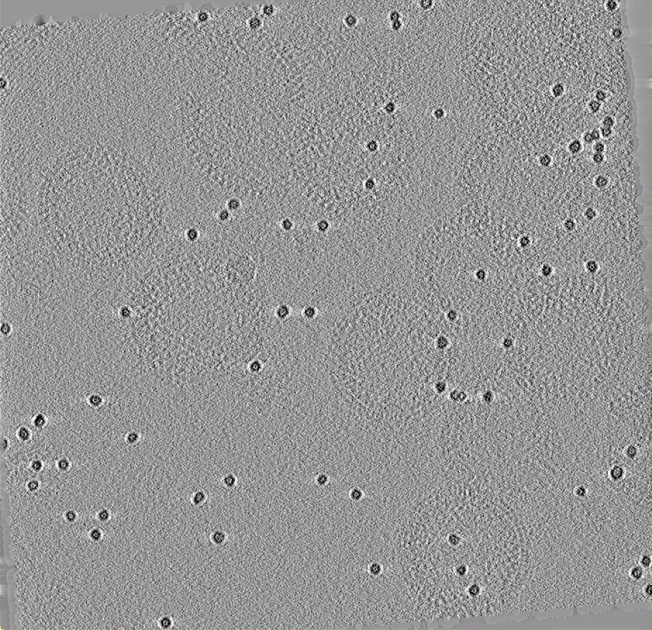
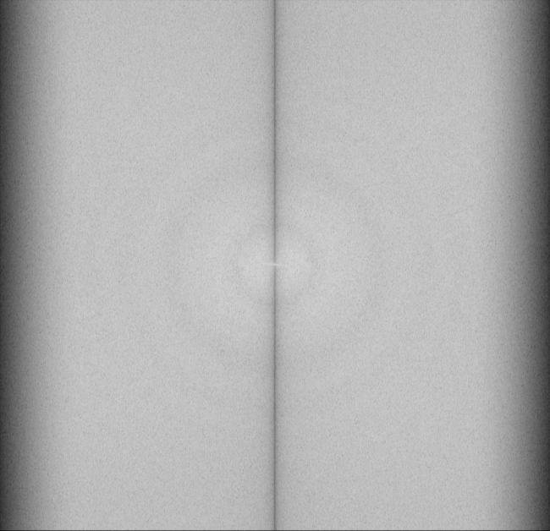
Cryo-ET reconstruction--WBP
CTF Thon ring
sirt image
FFT

Slide 21
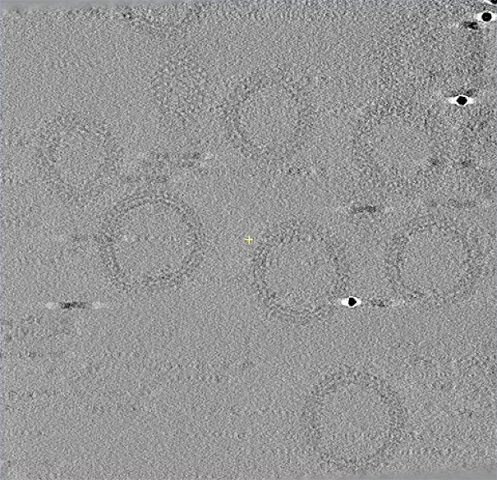
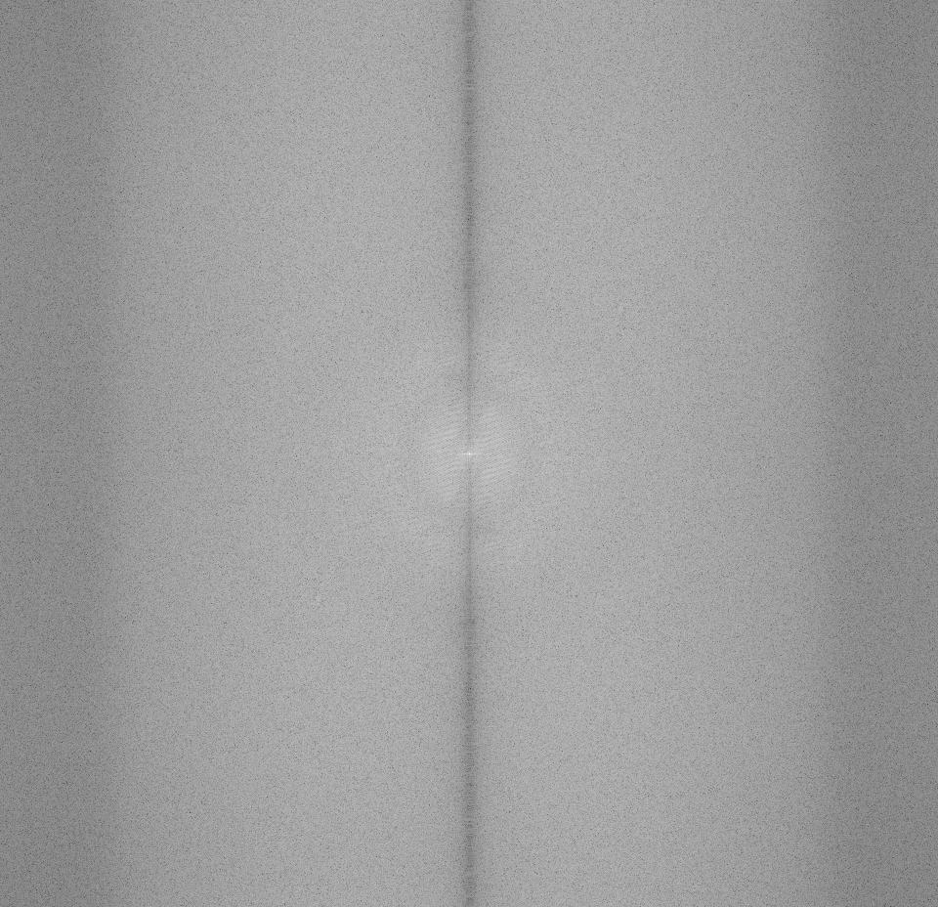
Cryo-ET reconstruction--WBP result
WBP reconstruction slice
FFT

Slide 22
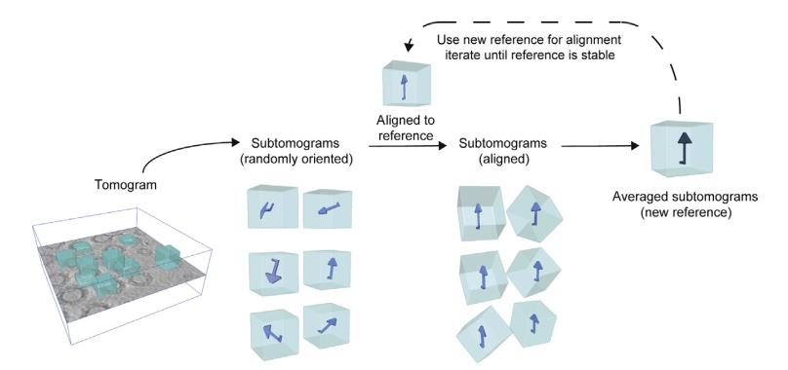
Recall: subtomo averaging

Slide 23
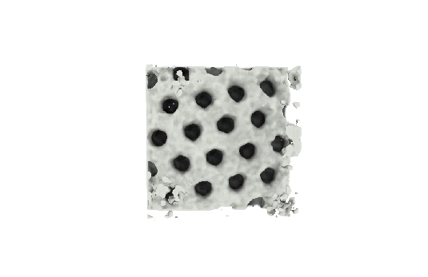
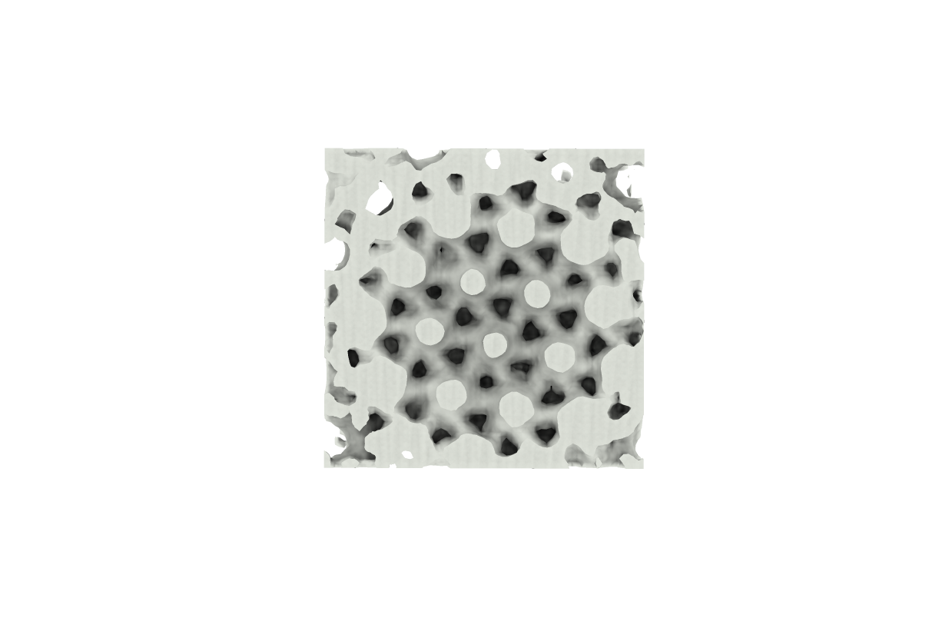
Cryo-ET reconstruction--WBP subtomo result

Slide 24
Cryo-ET reconstruction
Actually, there’re almost NO deep learning method about cryo-ET 3D reconstruction.
For EM, it is CryoDRGN, because there’re thousands of images with different poses to do fourier space reconstruction.
For ET, there’re only sparse-view images with limited angle, not suitable in fourier space.

Slide 25
Cryo-ET workflow

Slide 26
Denoise
Since both Cryo-ET and Cryo-EM have extremely low SNR, denoising is an important way to enhance data analysis quality with great potential.
But denoise is challenging in Cryo-EM/ET:
very high noise level
no ground truth clean image
hard to find a prior noise model

Slide 27
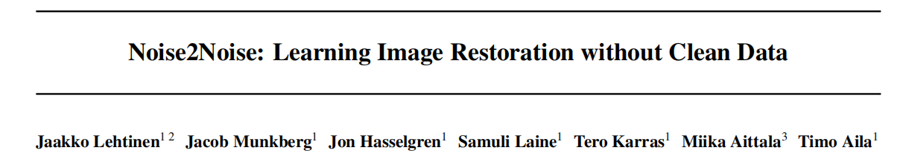
Denoise--N2N

Slide 28
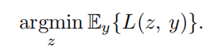
Denoise--N2N theory
Assume that we have a set of unreliable measurements $(y_{1},y_{2},...,y_{n})$ of the room temperature.
Then, to estimate the true temperature $z$, the function below is optimized:
If loss function is L2 loss, then $z=𝔼_{y}\{y\}$
If loss function is L1 loss, then $z=$ median of observation.

Slide 29
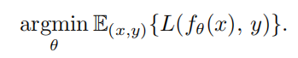
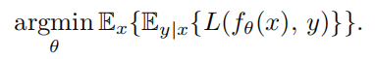
Denoise--N2N theory
For a neural network $f_{θ}$ with input-target pair $(x_{i},y_{i})$, the task is:
The full task can be decomposed to the same minimization problem at every training sample:

Slide 30
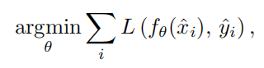
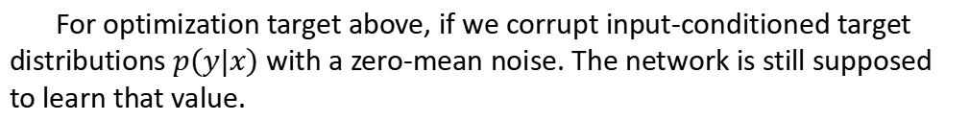
Denoise--N2N theory
The key of N2N: Training a neural network from low dimension to high dimension using L2 loss, the network is expected to output the average of all possible result.
For optimization target above, if we corrupt input-conditioned target distributions $p(y|x)$ with a zero-mean noise. The network is still supposed to learn that value.
where $\hat{x},\hat{y}$ are now drawn from corrupted distribution, conditioned on clean target $y$ such that $𝔼\{{\hat{y}}_{i}|{\hat{x}}_{i}\}=y_{i}$.

Slide 31
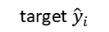
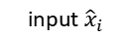
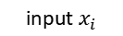
Denoise--N2N pipeline
corrupt with zero-mean noise
corrupt with zero-mean noise
input $x_{i}$
loss
U-net
input ${\hat{x}}_{i}$
prediction
target ${\hat{y}}_{i}$

Slide 32
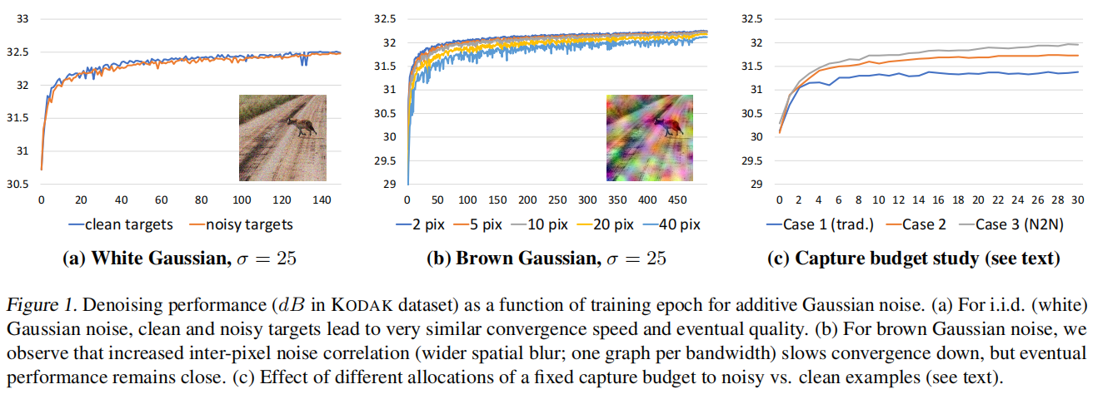
Denoise--N2N setup
Case 1: 100 pairs, each pair 20 images(1 clean + 19 noisy), clean target supervised
Case 2: 100 pairs, each pair 20 images(1 clean + 19 noisy), clean/noisy pairs N2N
Case 3: 1000 pairs, each pair 2 images(2 noisy), N2N

Slide 33
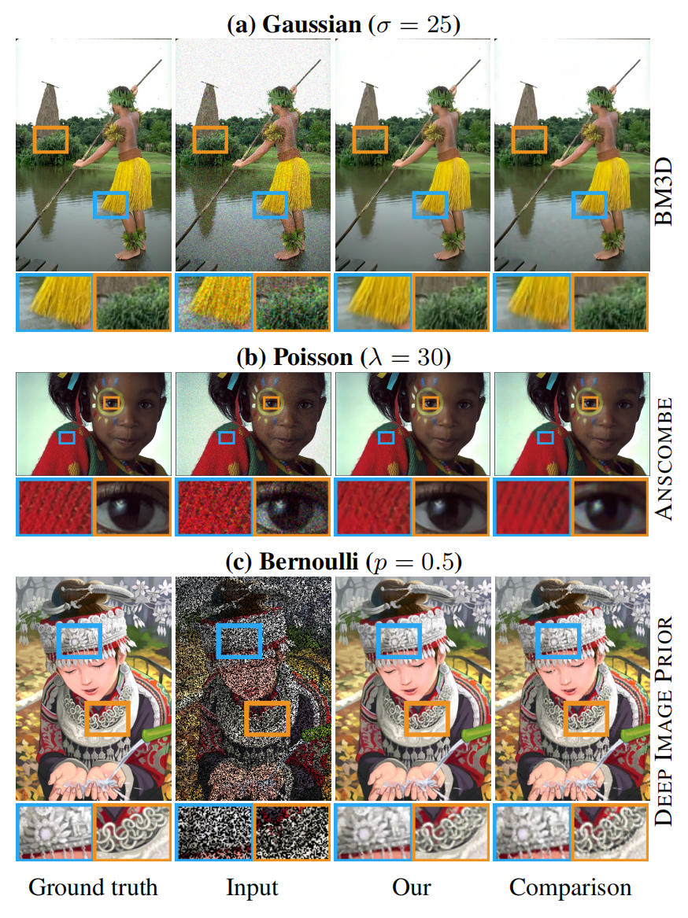
Denoise--N2N result
For input-conditioned noise, the L2 loss achieves better result.

Slide 34
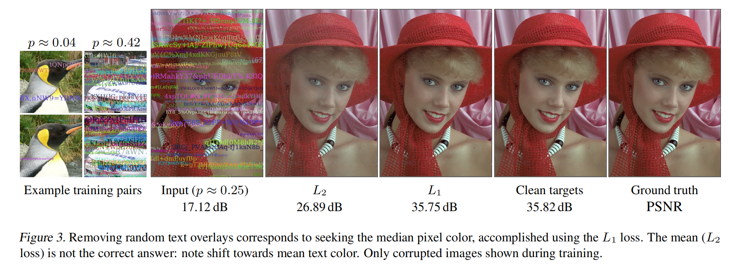
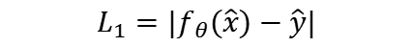
Denoise--N2N result
$$L_{1}=|f_{θ}(\hat{x})−\hat{y}|$$

Slide 35
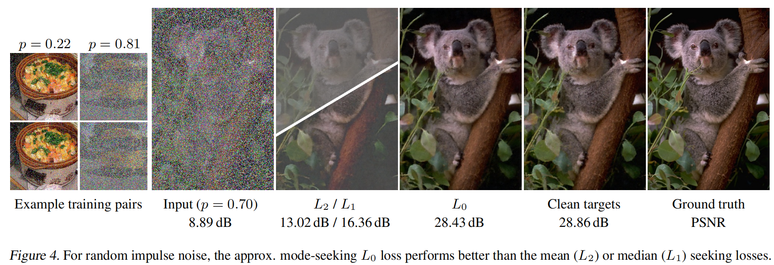
Denoise--N2N result
$L_{0}=(f_{θ}(\hat{x})−\hat{y}+ε)^{γ}$, with $γ$ decrease from 2 to 0 during training

Slide 36
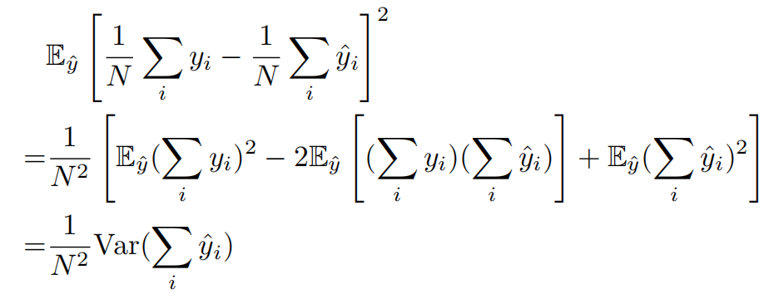
Denoise--N2N analysis
For L2 loss, the expected difference between means from corrupted and clean target is:
N2N has limits:
Need a big amount of paired noisy data (impossible in many scenario)
Need the noise to be zero-mean
High noise level will harm the performance

Slide 37
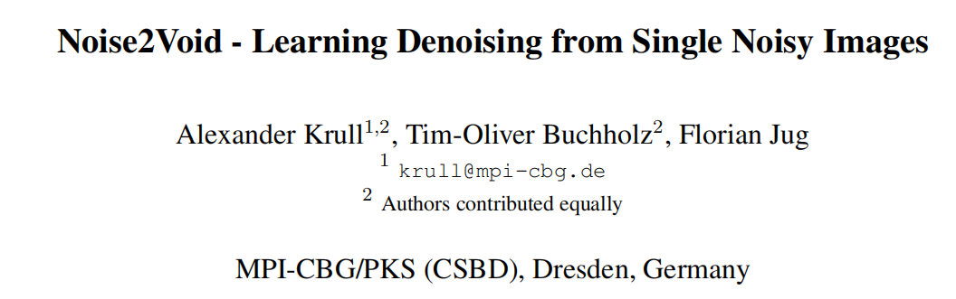
Denoise--N2V

Slide 38
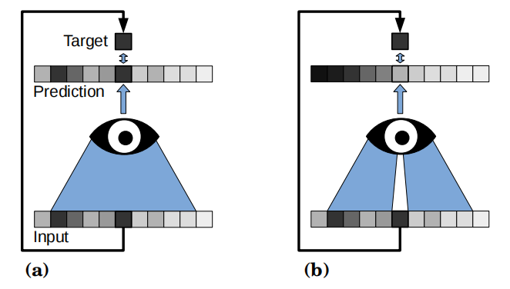
Denoise--N2V theory
blind-spot receptive field

Slide 39
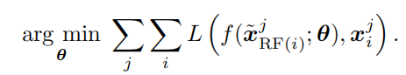
Denoise--N2V theory
In N2N, if single noisy images are used instead of paired noisy images, the CNN network will finally only focus on the target pixel and ignore the pixels around.
In N2V, using blind-spot training means to optimize:
which enables single image denoising.

Slide 40
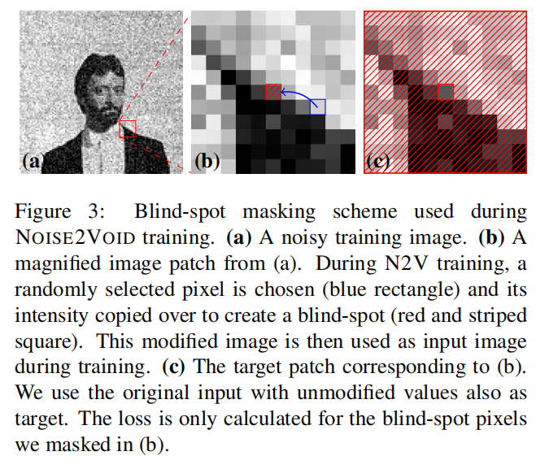
Denoise--N2V setting

Slide 41
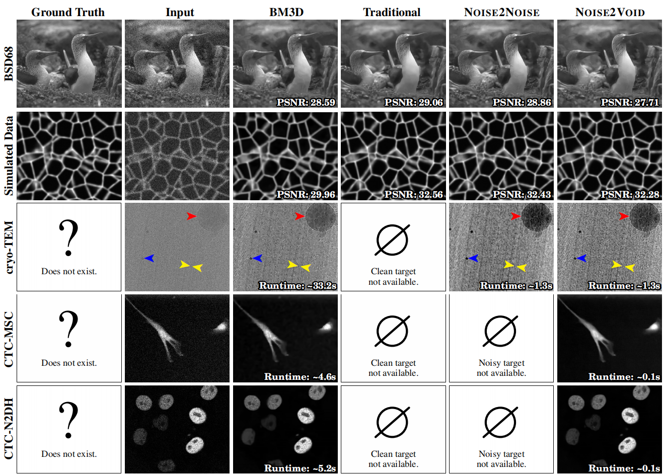
Denoise--N2V result

Slide 42
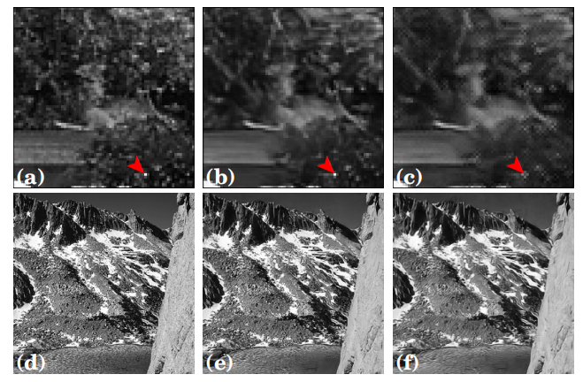
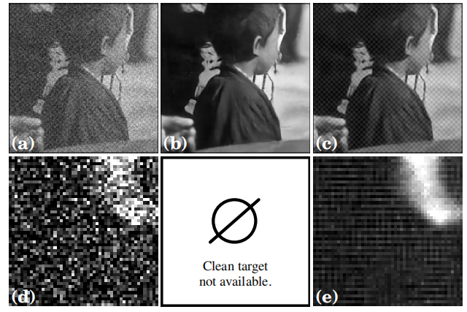
Denoise--N2V result (failure case)
impulse point
structure noise

Slide 43
Denoise--N2V vs N2N
N2N | N2V
paired noisy image | single noisy image
zero-mean noise | zero-mean noise
various types of noise model | only input-dependent noise
Fortunately, in cryo data, we have movie frames.

Slide 44
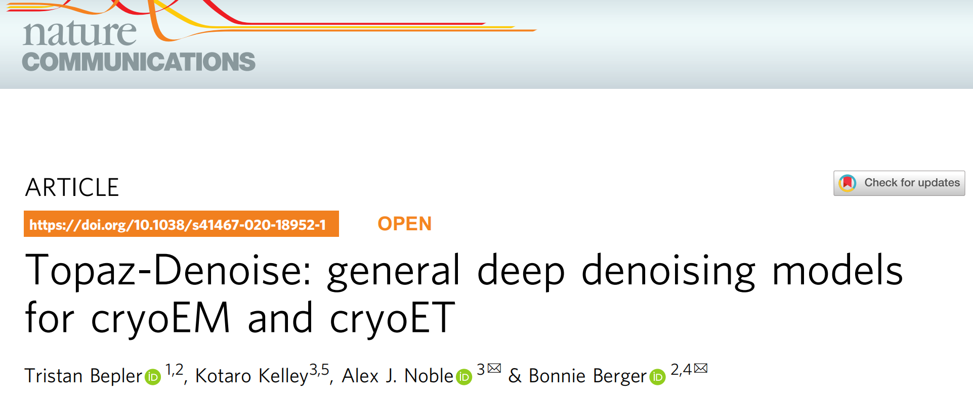
Denoise--Topaz

Slide 45
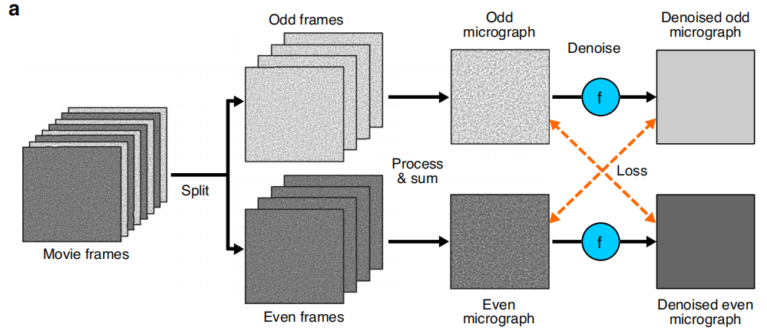
Denoise--Topaz pipeline
N2N-based pipeline

Slide 46
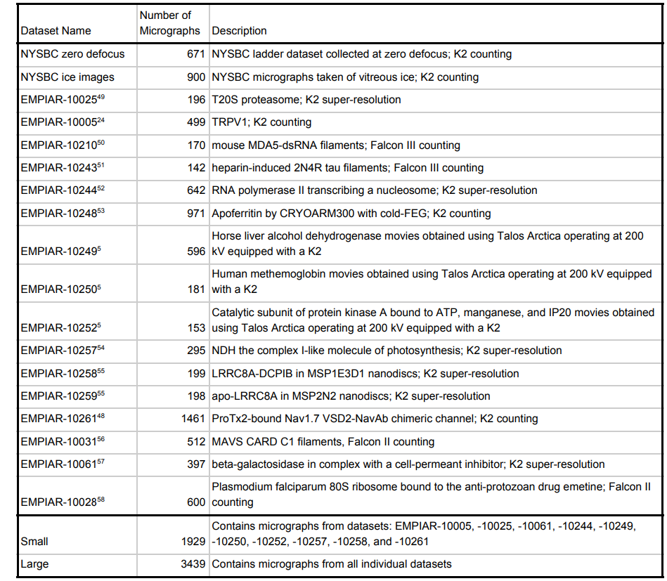
Denoise--Topaz dataset

Slide 47
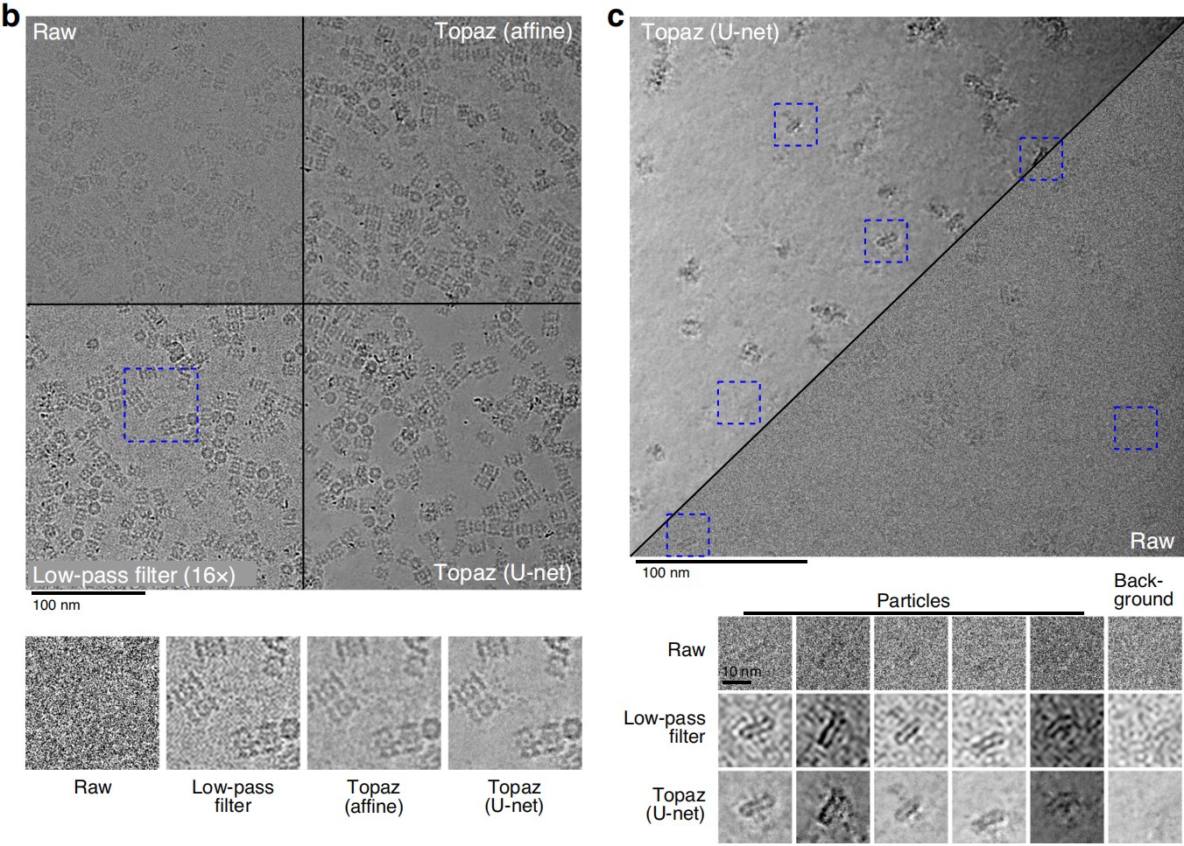
Denoise--Topaz result

Slide 48
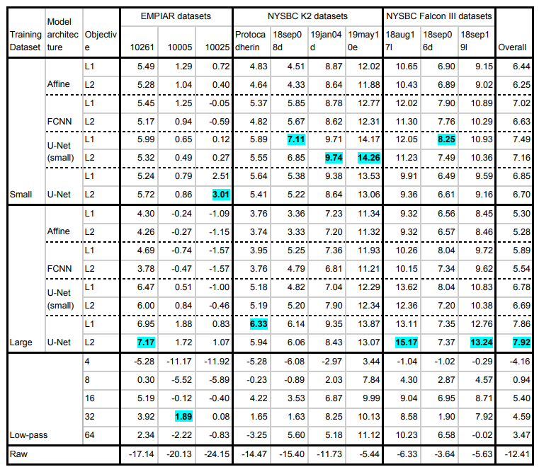
Denoise--Topaz result
L1 is slightly better than L2 in small model
Full Unet with L2 loss and large dataset performs best.

Slide 49
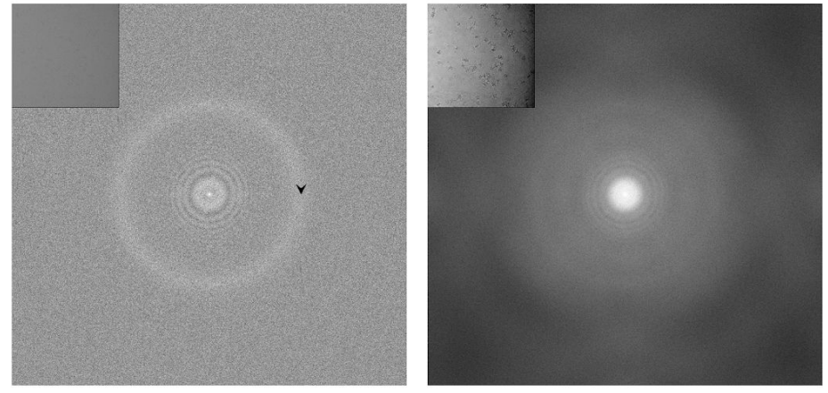
Denoise--Topaz result
raw
Topaz

Slide 50


Denoise--Topaz result
Topaz denoise improves interpretability and picking of difficult particle projections

Slide 51

Denoise--Topaz result
randomly select 1000 particles to reconstruct
Topaz denoised particles are less reliable.

Slide 52

Denoise--Topaz result
Topaz denoise enhances SNR of short exposure micrographs.

Slide 53


Denoise--Topaz pipeline (3D)
denoised odd volume
WBP odd reconstruction
3D U-net
loss
split
denoised even volume
WBP even reconstruction
3D U-net
odd frames data
even frames data

Slide 54


Denoise--Topaz result (3D denoise)

Slide 55
Denoise--Topaz limitation
Topaz denoise has several limitation:
requirement for large datasets
denoised images/volumes may have hallucinated signal which will harm the high frequency signal.
“we recommend that Topaz-Denoise models be used to assist with visualization and object identification, then the objects of interest be extracted and processed from raw micrographs/tomograms.”

Slide 56





Denoise--other AI application on ET
based on N2N (noisier2noise)
based on N2V

Slide 57
Cryo-ET workflow

Slide 58

cryo-ET particle picking

Slide 59

cryo-ET particle picking
In Cryo-EM, 2D particle picking is essential for classification and reconstruction, particle are 2D images.
In Cryo-ET, particle is picked after reconstruction, particles are 3D volumes.

Slide 60

cryo-ET particle picking

Slide 61

cryo-ET particle picking
Both strategies have label noise problem

Slide 62

cryo-ET particle picking result

Slide 63


cryo-ET particle picking result

Slide 64

cryo-ET particle picking result

